Slide 1

What we learn in this lecture?
Introduction: What is the strategy keyword?
The benefits of using strategy in your workflows
Examples of resource allocation in workflows
Defining a matrix for executing parallel jobs
Setting a max-parallel limit for job concurrency
Using fail-fast to terminate jobs when others fail
Best practices for using strategy in your workflows
Conclusion: How strategy can improve your workflow performance?

Slide 2



What is strategy in Workflows
Notes:
Alright, so the strategy keyword in GitHub workflows is like playing chess. You know how a chess player thinks ahead, plans their moves, and uses their resources wisely? Well, developers can use strategy in the same way to make their workflow better and get the results they want. It's like when a chess player sacrifices a piece to get an advantage or to protect a more valuable piece. Developers can prioritize certain jobs or give more resources to a critical task by using strategy. And just like how a chess player adjusts their strategy based on their opponent's moves or the changing game board, developers can also adapt their workflow to different environments or requirements. By using strategy, developers can plan ahead, make the most of their resources, and achieve their goals more efficiently, just like a pro chess player.

Slide 3
Examples of resource allocation in workflows
Prioritizing critical tasks: You can use strategy to allocate more resources like computing power and time to critical tasks such as building and testing your application before deploying it to production.
Parallelizing jobs: Running jobs in parallel can optimize resource usage and reduce the overall execution time of your workflow. For instance, you can run tests for different parts of your application in parallel to speed up the testing process.
Customizing environment variables: By using environment variables, you can configure your workflow to use different resources or settings depending on the task or environment. You can configure your workflow to use different databases for development and production environments, for example.
Using caching: Caching can be used to optimize resource usage and reduce the time it takes to run your workflow. You can cache dependencies or build artifacts to avoid rebuilding them every time you run the workflow.
Notes:
Here are some examples of resource allocation in workflows:
Prioritizing critical tasks: You can use strategy to allocate more resources (e.g. computing power, time) to critical tasks in your workflow, such as building and testing your application before deploying it to production.
Parallelizing jobs: By running jobs in parallel, you can optimize resource usage and reduce the overall execution time of your workflow. For example, you can run tests for different parts of your application in parallel to speed up the testing process.
Customizing environment variables: You can use environment variables to configure your workflow to use different resources or settings depending on the task or environment. For instance, you can configure your workflow to use different databases for development and production environments.
Using caching: You can use caching to optimize resource usage and reduce the time it takes to run your workflow. For example, you can cache dependencies or build artifacts to avoid rebuilding them every time you run the workflow.
These are just a few examples of how you can use strategy to allocate resources in your workflows. The key is to think ahead, plan your moves, and allocate your resources wisely to achieve the desired outcome.

Slide 4
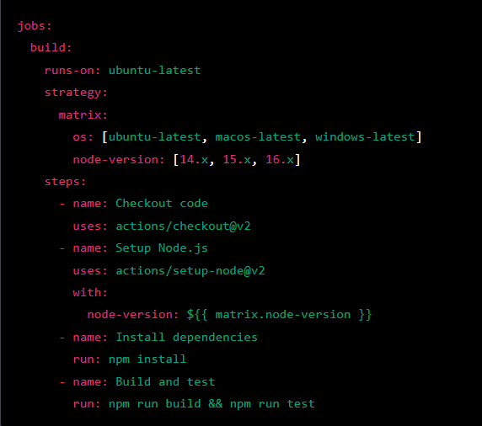
Defining a matrix for executing parallel jobs
Notes:
To execute parallel jobs in GitHub workflows, you can define a matrix of parameters that generate a list of job configurations. Each job configuration represents a unique set of parameter values, allowing you to run multiple jobs in parallel with different configurations. This simplifies workflow configuration, reduces duplication of job configurations, and lets you customize the environment for each job. In this example, we define a build job that runs on multiple operating systems and Node.js versions using the matrix strategy. The matrix defines the combinations of operating system and Node.js version to be used for running the job in parallel.
The job consists of several steps, including checking out the code, setting up Node.js, installing dependencies, and building and testing the application. The steps are executed in parallel for each combination of operating system and Node.js version defined in the matrix.
This approach allows for efficient use of resources and faster execution of the job by running multiple tasks in parallel.

Slide 5
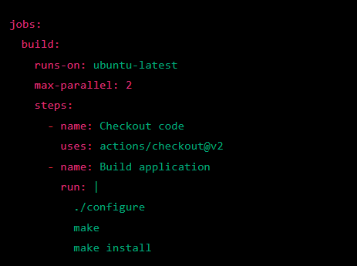
Setting a max-parallel limit for job concurrency
Notes:
When running jobs in parallel on GitHub workflows, it's important to keep in mind the resources that are available to you. You don't want to overwhelm your system by running too many jobs at once, or risk running out of resources. This is where setting a max-parallel limit for job concurrency comes in handy.
By setting a max-parallel limit, you can specify the maximum number of jobs that can be run in parallel at any given time. This allows you to optimize resource usage and prevent resource exhaustion. For example, if you have a limited number of computing resources, you can set a max-parallel limit to ensure that you don't run too many jobs at once and overload your system.
Overall, setting a max-parallel limit can help you optimize your workflow and ensure that your resources are used efficiently, without overwhelming your system.
In this example, the build job is limited to a maximum of 2 parallel runs, which means that no more than 2 instances of this job can be running at the same time.

Slide 6
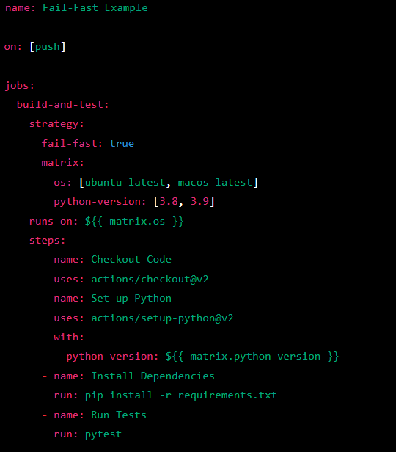
Using fail-fast to terminate jobs when others fail
Notes:
"Fail-fast" is a useful technique for improving the efficiency and reliability of your GitHub workflows. Essentially, it means setting your workflows to terminate as soon as a job fails, rather than continuing to run all jobs even if one has failed. This helps prevent wasted resources and ensures that any issues are caught and addressed as quickly as possible.
For example, let's say you have a workflow that builds and deploys an application. If the build job fails, it doesn't make sense to continue with the deployment job, since the application won't be in a deployable state. By setting the "fail-fast" option in your workflow, you can automatically terminate the workflow as soon as the build job fails, saving resources and allowing you to quickly address the issue.
By using "fail-fast", you can make your workflows more efficient and reliable, and catch issues early on in the process.
In this workflow, we define a build-and-test job that uses the fail-fast strategy with a matrix of os and python-version parameters. The fail-fast strategy means that if one job configuration fails, the entire workflow will be marked as failed and no more jobs will be run.
For example, if the ubuntu-latest configuration with python-version 3.8 fails, the workflow will be marked as failed and the job for macos-latest will not be run. This helps to save resources and avoid wasting time running jobs that will likely fail if a previous job has already failed.
By using the fail-fast strategy, you can quickly identify and fix issues in your workflow, and ensure that only successful jobs are executed.

Slide 7

Best Practices
1. Think ahead:
2. Keep it simple:
3. Test your workflows:.
4. Use descriptive names
5. Monitor resource usage:
6. Document your workflows
Notes:
Hey there! So, you want to know about the best practices for using strategy in your workflows? Great! Let me tell you about some of the best practices that you should follow:
1. Think ahead: Before you start creating your workflows, think about the resources that you'll need and how you can optimize them using strategy.
2. Keep it simple: Don't try to overcomplicate your workflows with too many strategies. Keep it simple and use only the strategies that are necessary.
3. Test your workflows: Always test your workflows before deploying them to ensure that they work as expected.
4. Use descriptive names: Use descriptive names for your jobs, strategies, and matrix parameters to make it easy to understand what they do.
5. Monitor resource usage: Keep an eye on the resource usage of your workflows and adjust your strategies accordingly to ensure optimal performance.
6. Document your workflows: It's important to document your workflows so that others can understand how they work and make changes if needed.
By following these best practices, you can use strategy effectively in your workflows and achieve your desired outcomes more efficiently.

Slide 8
Conclusion: How strategy can improve your workflow performance
Resource optimization:
Parallel processing:
Customization:
Error handling:
Simplicity:
Notes:
sing strategy in your workflows has many benefits that can improve your workflow performance and efficiency.
Here are some advantages you can get by using strategies in your workflows:
Resource optimization: You can allocate your resources such as computing power, time, and memory in a more efficient way, resulting in better performance and faster execution times.
Parallel processing: By using the parallel strategy, you can execute multiple jobs at the same time and take advantage of modern hardware to speed up the workflow execution.
Customization: With matrix and environment strategies, you can easily customize your workflow to fit different scenarios and environments, making it more flexible and adaptable.
Error handling: The fail-fast and timeout strategies can help you improve the error handling in your workflows by allowing you to quickly identify and resolve issues before they cause delays or failures.
Simplicity: By using strategies, you can simplify your workflow configuration, reduce duplication, and make it easier to manage and maintain. This can lead to increased productivity and less time spent on troubleshooting and maintenance.
Overall, the strategy keyword provides a powerful tool for optimizing and customizing your workflows, leading to improved performance, flexibility, and error handling. So, why not give it a try and see the benefits for yourself?

